Slide 1
Model Based Signal Analysis
Group Details:
K Vamsi Krishna (S20200020276)
G B Sayee Sreenivas (S20200020259)
K Sai Subhash Yadav (S20210020291)

Slide 2
Background
Accurately estimating parameters like amplitude (A), phase (∅), and frequency (f0) of sinusoidal signals is crucial in signal processing. However, real-world signals are often corrupted by noise, making estimation challenging.
This project aims to develop robust methods for parameter estimation of sinusoidal signals in noisy environments. Through synthetic data generation and systematic parameter estimation using the Newton-Raphson method, the goal is to derive accurate estimates even in the presence of significant noise.
By analyzing the behavior of estimation algorithms through Monte Carlo simulations, this project seeks to enhance signal processing techniques and improve the reliability of signal analysis in practical applications.

Slide 3
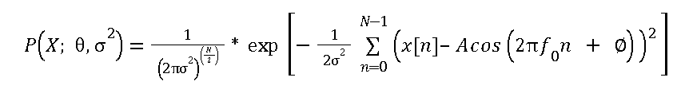
Problem Statement
Estimating the parameters of a sinusoidal signal corrupted by additive white Gaussian noise using MLE.
Chosen Model
x(n) = A*cos(2*π*f₀*n + ∅) + w(n)
w(n) ~ N(0,σ²)
x(n): Observed signal
A: Amplitude of the sinusoidal signal
𝑓₀: Frequency of the sinusoidal signal
∅: Phase of the sinusoidal signal
w(n): Additive White Gaussian noise

Slide 4
List of Assumptions
The signal model assumes a sinusoidal waveform corrupted by additive Gaussian noise.
The noise is assumed to be independent and identically distributed (i.i.d) Gaussian.
The parameters of interest (amplitude, phase, frequency) are assumed to be constant over time.
Parameters
A: Amplitude of the sinusoidal signal
𝑓₀: Frequency of the sinusoidal signal
∅: Phase of the sinusoidal signal
N: Number of data points
σ: Noise variance

Slide 5
Methods for Parameter Estimation
Newton-Raphson Method for Amplitude (A) and Phase (∅) Estimation
Utilizes the gradient and Hessian of the log-likelihood function with respect to A and ∅.
Updates the estimate of A and ∅ iteratively until convergence.
Estimation of Frequency (f₀)
Utilizes a custom function to estimate f₀ based on the maximization of a specific function of the signal.
Finds the frequency for which the function is maximized, providing an estimate of f₀.
Monte Carlo Simulations
Analyzes the behavior of parameter estimations under various scenarios.
Varies parameters such as sample size (N), noise variance (σ), true frequency (f₀_true), true_Amplitude(A), and true phase (∅).

Slide 6
Method of Simulation
1. Synthetic Data Generation:
Generate synthetic sinusoidal signals with known parameters (amplitude, frequency, phase).
Add Gaussian noise to the signals to simulate real-world noisy environments.
2. Parameter Estimation:
Implement Newton-Raphson method for amplitude and phase estimation.
Develop a custom function to estimate frequency based on signal characteristics.
3. Monte Carlo Simulations:
Conduct multiple simulations varying parameters such as:
Sample size (N): Explore different numbers of data points.

Slide 7
Noise variance (σ): Investigate the impact of noise levels on estimation.
True frequency (f0_true): Test under various frequency conditions.
True_Amplitude(A): Estimate the remaining parameters for different amplitude values.
True phase (∅): Analyze estimation performance with different phase values.
4. Analysis and Evaluation:
Analyze the behavior of parameter estimations across simulation runs.
Evaluate the accuracy and reliability of estimation methods under different conditions.
Interpret results to gain insights into the effectiveness of parameter estimation techniques in noisy environments.

Slide 8
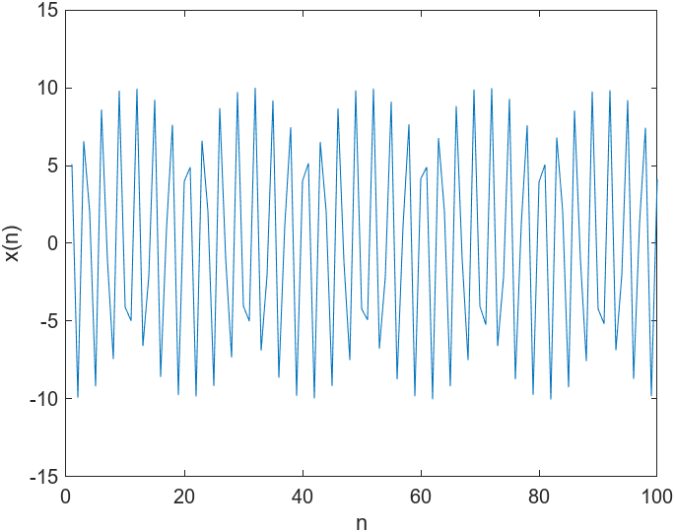
Results
Signal Model

Slide 9



Estimation of A using Newton Raphson Method
Estimation of A using Newton Raphson Method
Estimation of f₀

Slide 10
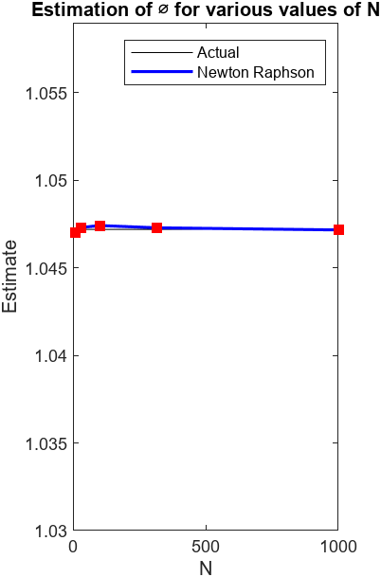
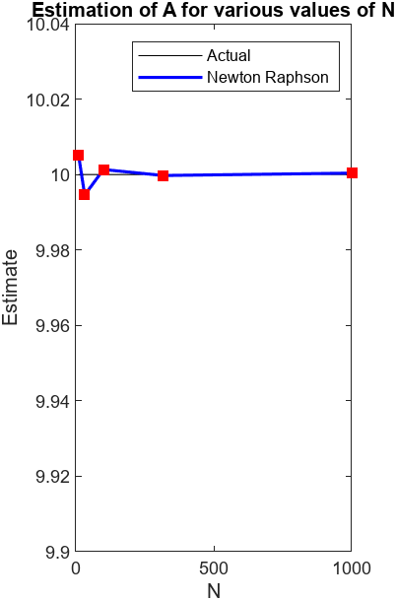
Varying N and estimating the parameters

Slide 11
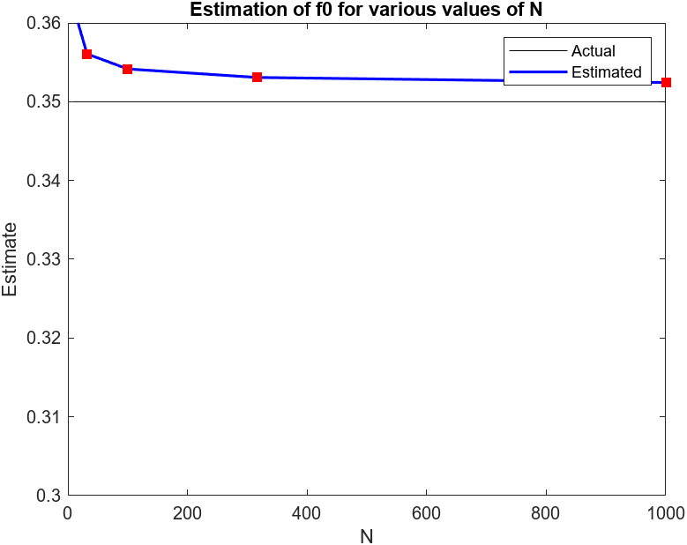

Slide 12
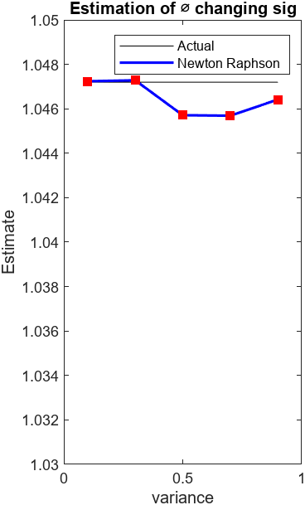
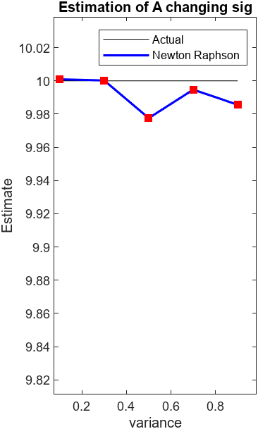
Varying sig and estimating the parameters

Slide 13
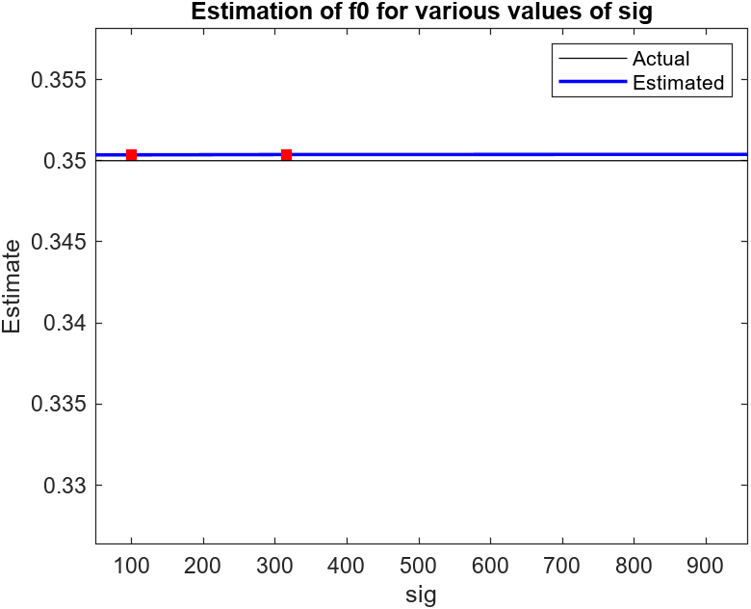

Slide 14
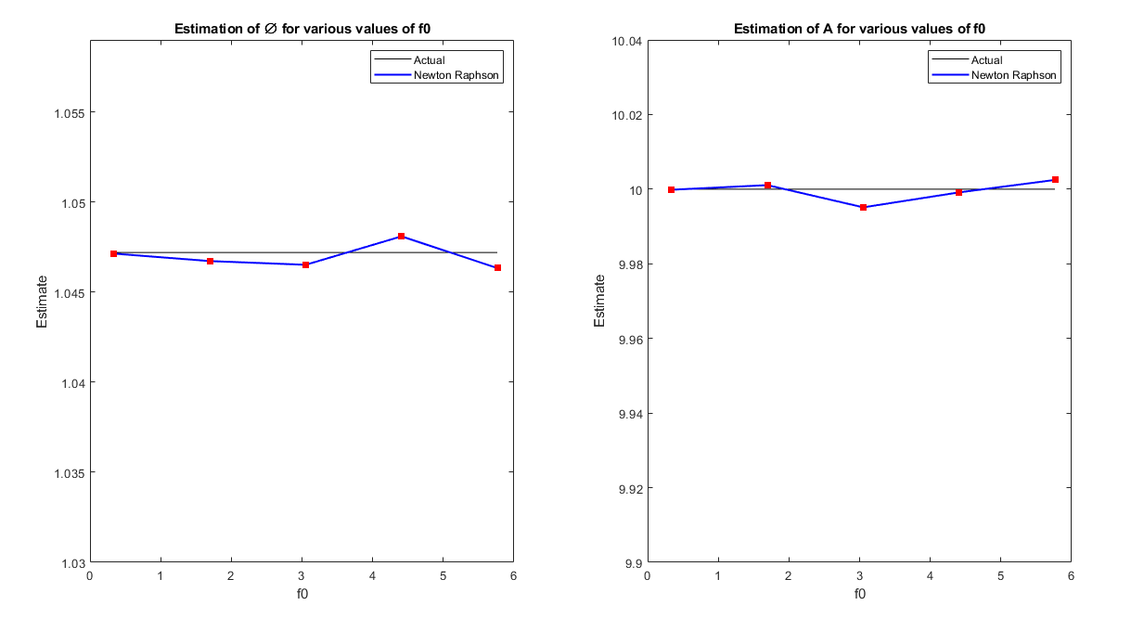
Varying f₀ and estimating the parameters

Slide 15
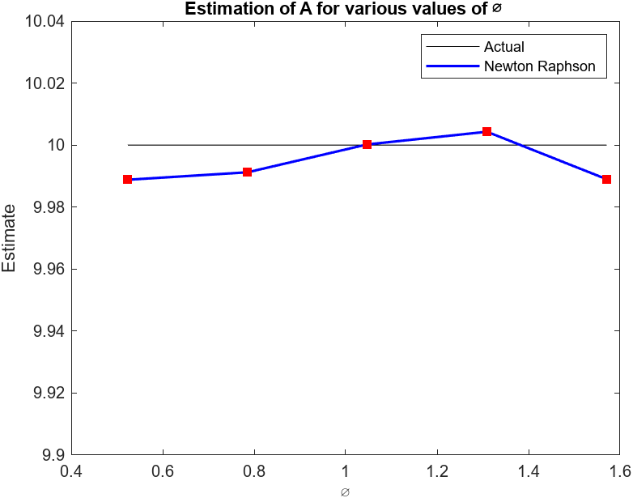
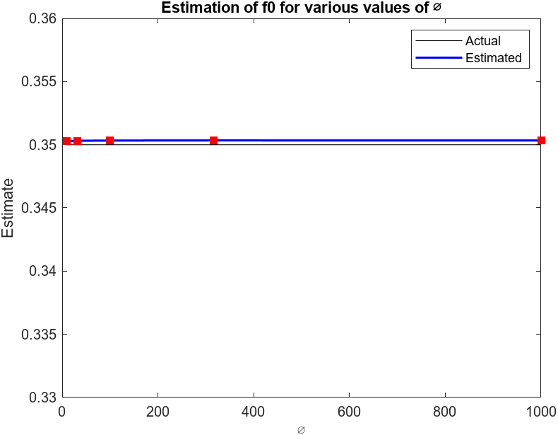
Varying Ø and estimating the parameters

Slide 16
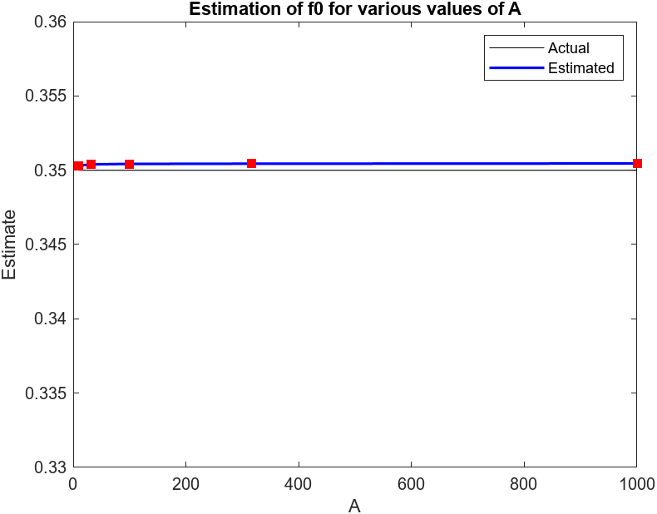
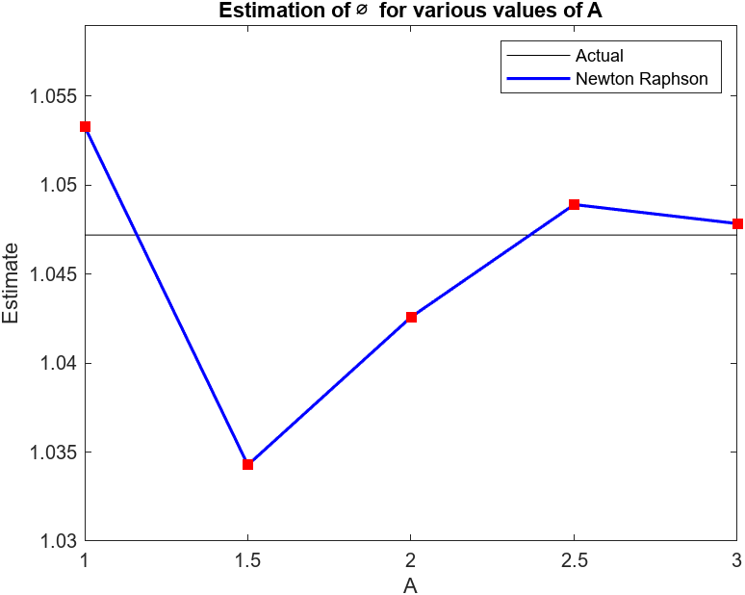
Varying A and estimating the parameters

Slide 17
THANK YOU

